Slide 1
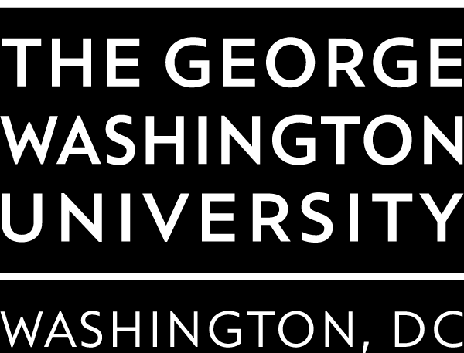
IMDB Feature Film Analysis
Team 02 - Deep Learner
Shuting Cai
Siddharth Das
Mrunalini Devineni
Yue Li

Slide 2
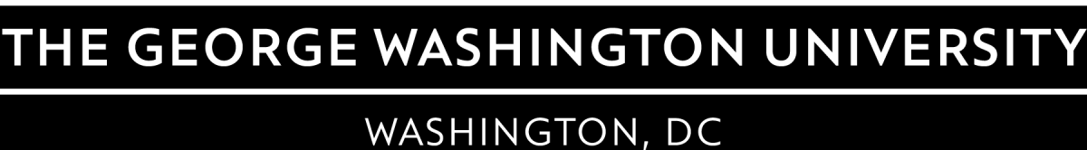
Features
Movie Genres
Director
Movie Language
Movie Duration
Viewer gender
Viewer age
Movie Rating
Vote numbers

Slide 3
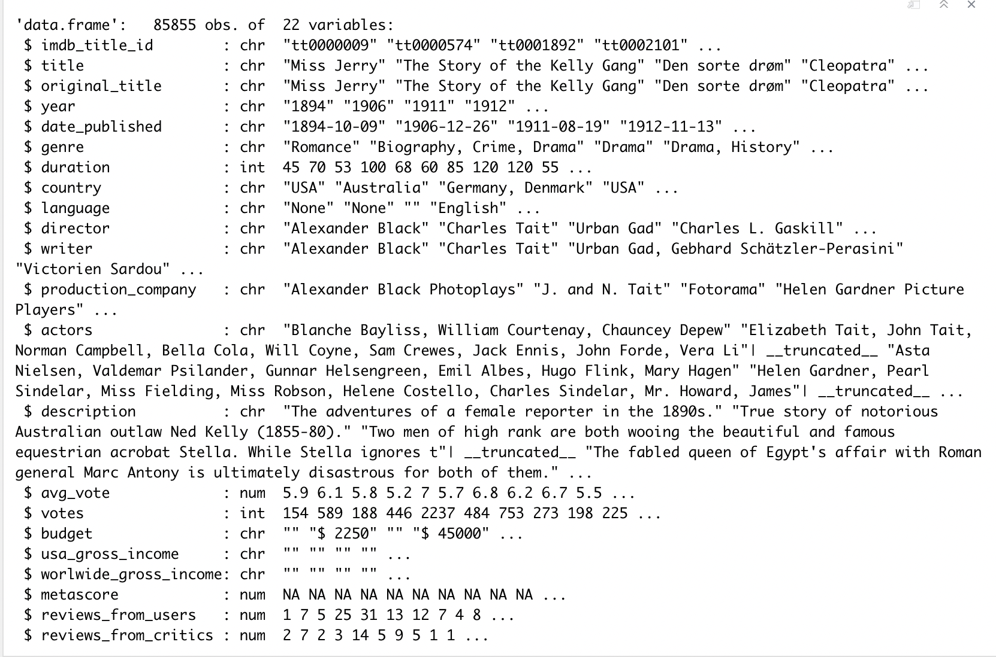
About the Dataset:
The dataset comprises of 85,855 movie instances of 22 variables.
It also includes 297,705 cast instances corresponding to the movies.

Slide 4
Preparation
Dropped unneeded variables columns, dropped the rows with missing values.
Subsetted the data used for data analysis.
Test:
T-test
Cor-test
Anova
Graphs:
Histogram
QQ-plot
Barplot
Boxplot
Scatterplot

Slide 5
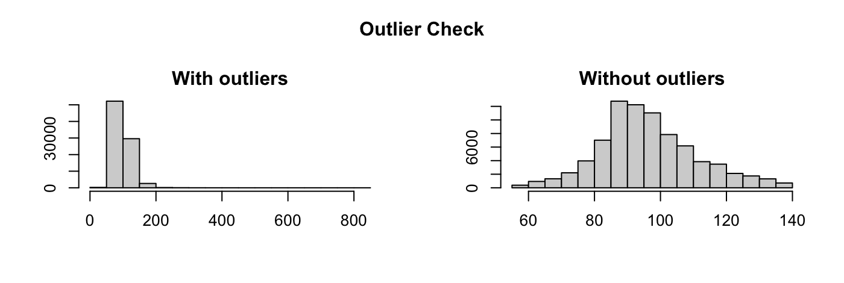
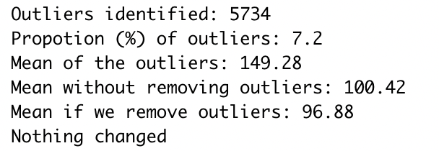
Outliers
Outliers- durations

Slide 6
Exploratory Data Analysis

Slide 7
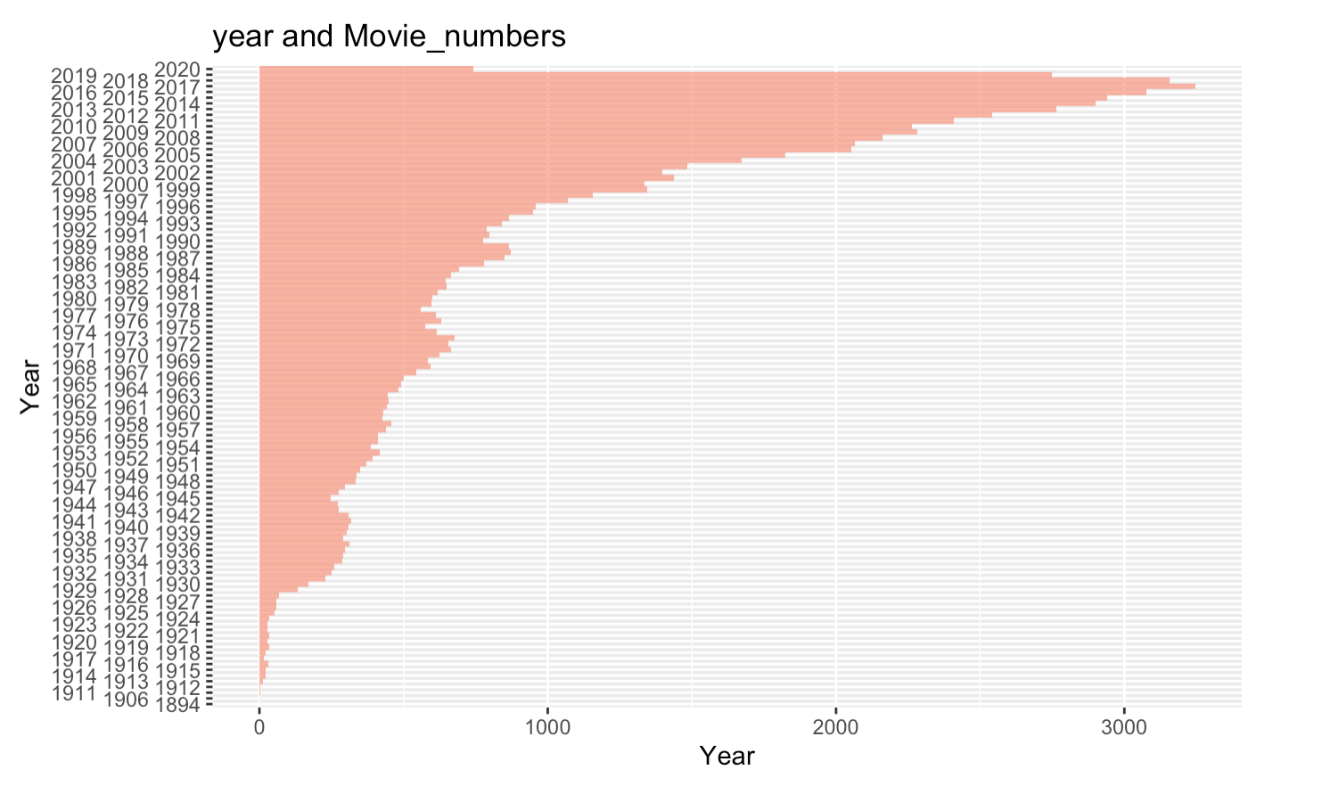
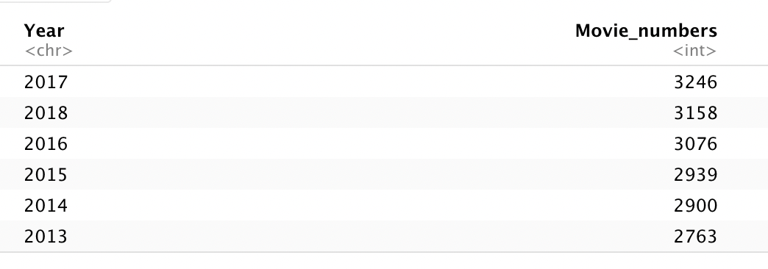
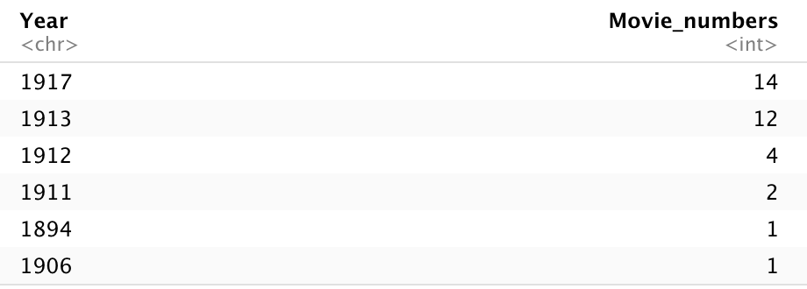
Movie numbers released in each year
Figure 1. The bar plot of movie number vs. year.

Slide 8
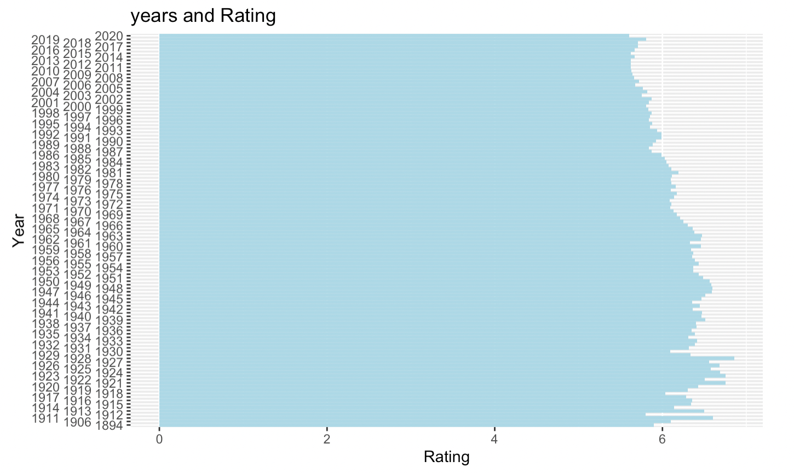
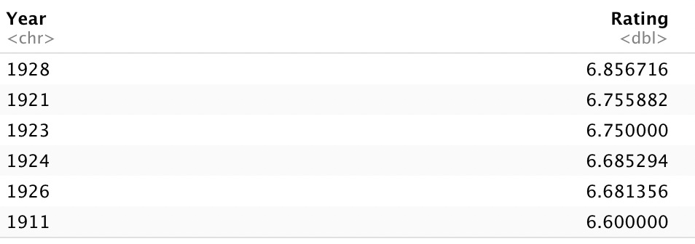
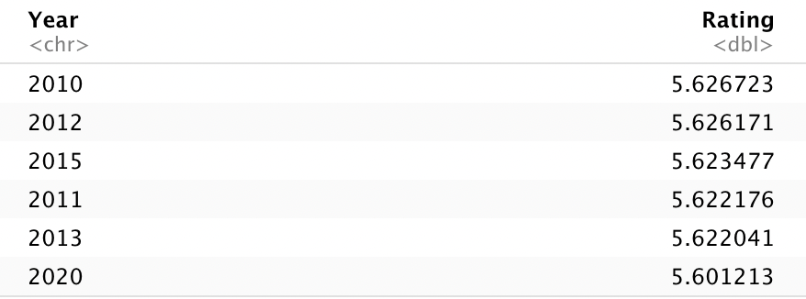
Mean of movie rating in each year
Figure 2. The barplot for the movie rating vs. year.

Slide 9
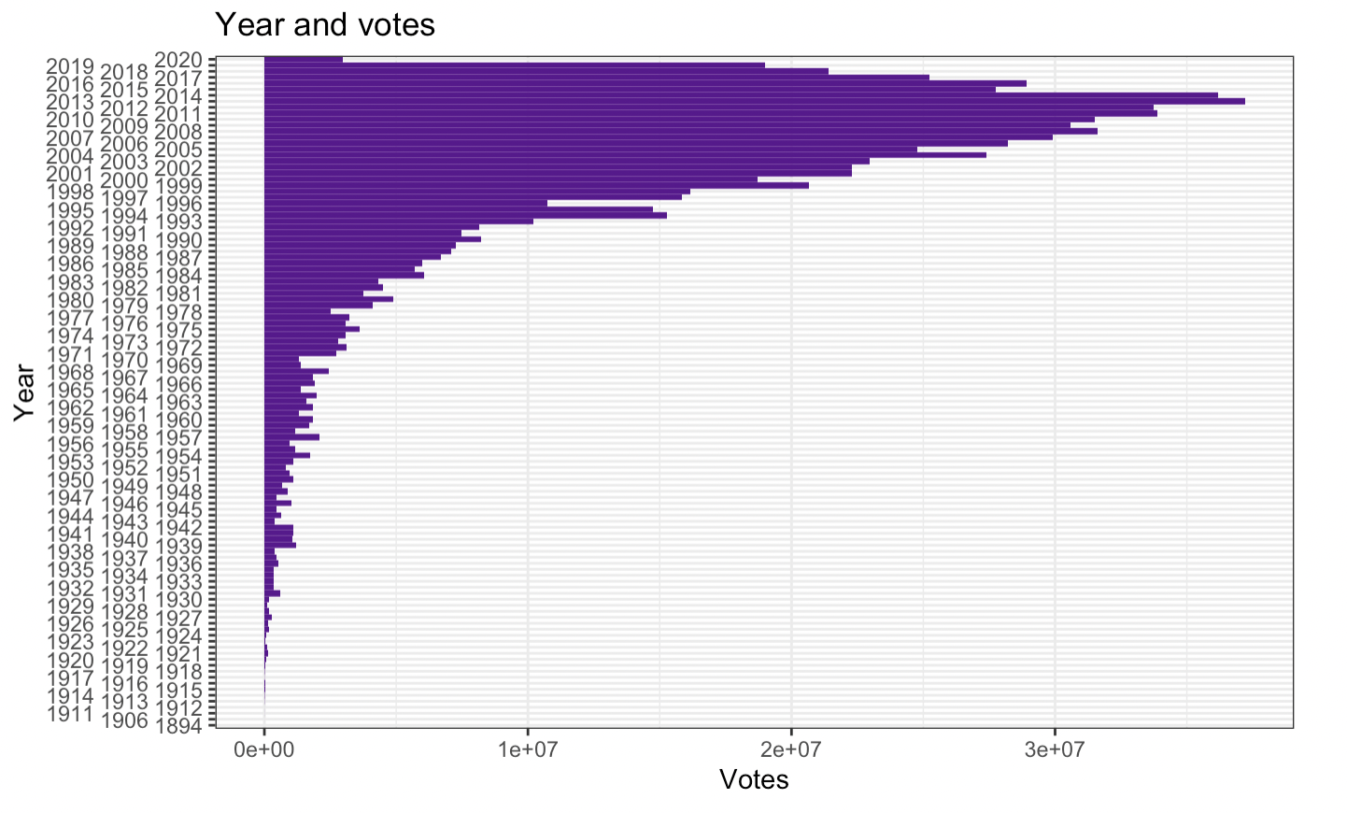
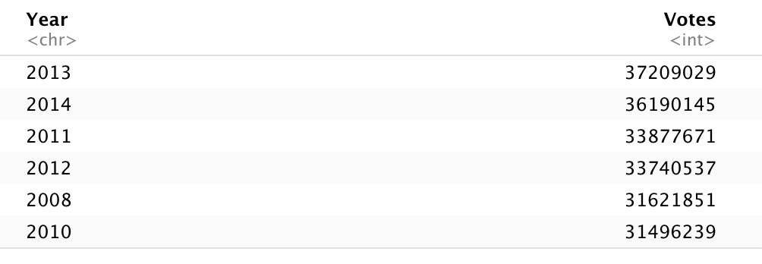
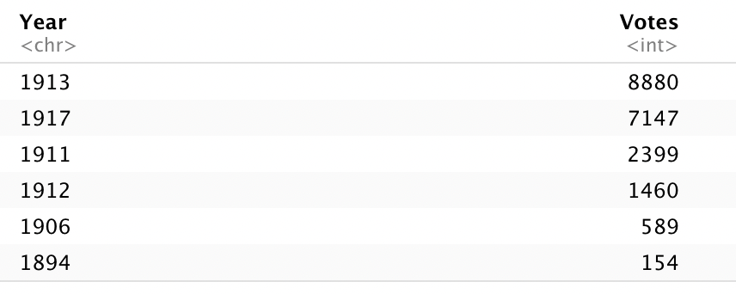
Sum of the vote numbers in each year
Figure 3. The barplot for the sum of movie votes vs. year.

Slide 10
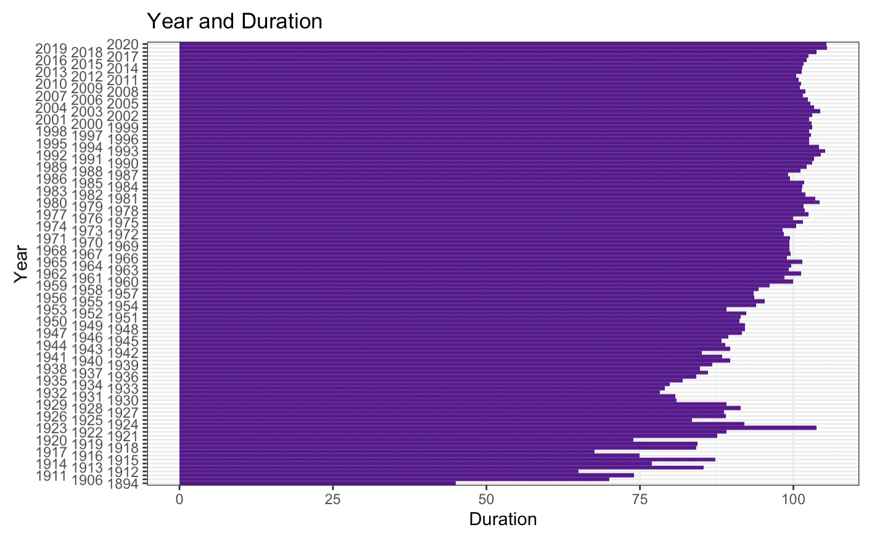
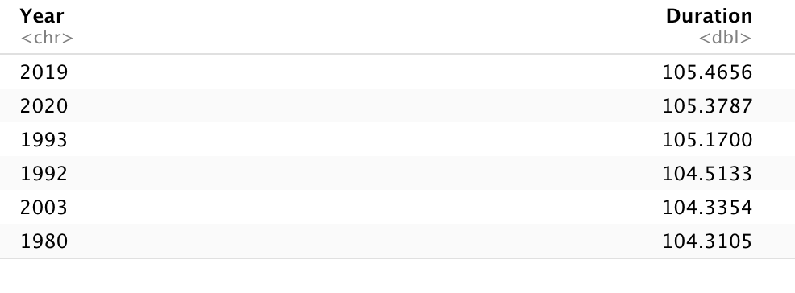
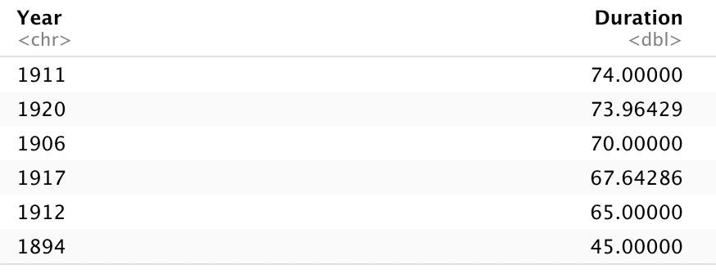
Movie duration changes in each year
Figure 4. The bar plot of the movie duration vs. year.

Slide 11
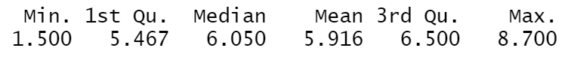
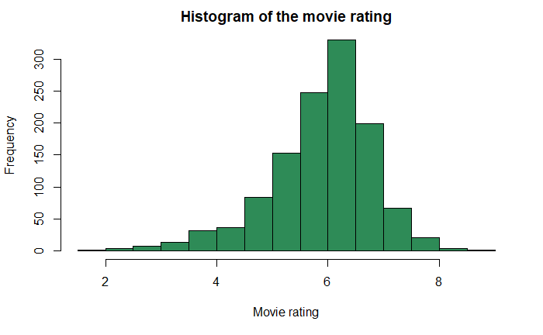
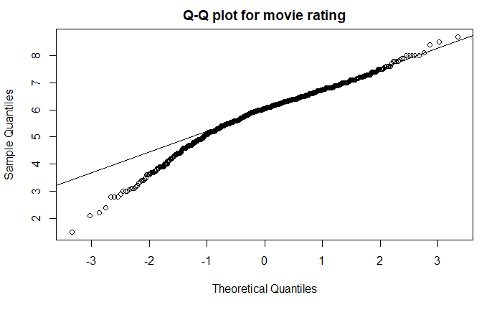
Movie rating & Q-Q Plot
Figure 5. The histogram plot of the movie ratings.
Figure 6. The Q-Q plot: Movie ratings.

Slide 12
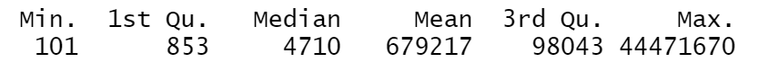
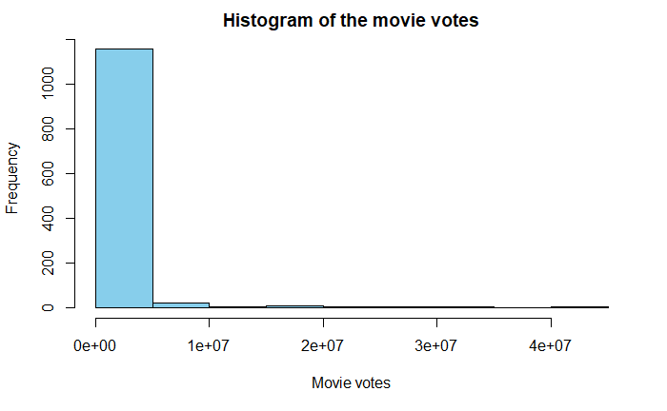
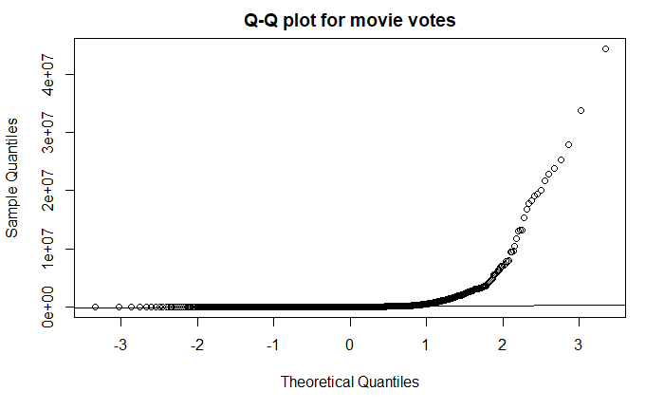
Movie votes & Q-Q Plot
Figure 7. The histogram plot of the movie votes.
Figure 8. The Q-Q plot: Movie votes.

Slide 13
SMART Questions

Slide 14
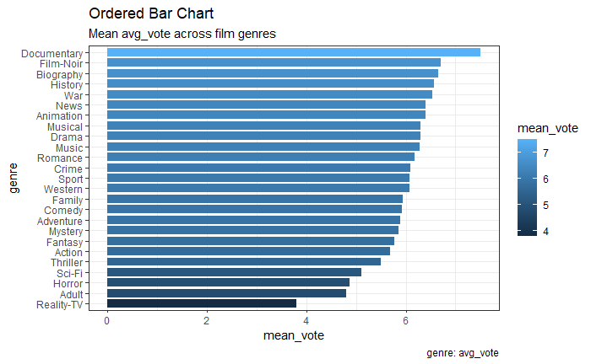
Q1: movie genre vs. movie rating
Figure 9. The bar plot of the movie genre vs. movie rating.

Slide 15
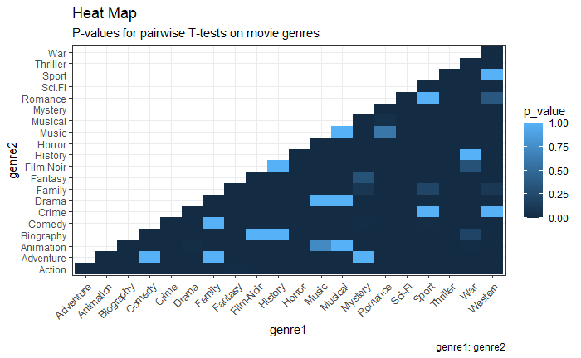
Correlation map of movie genre
Figure 10. The heatmap of the movie genres.

Slide 16
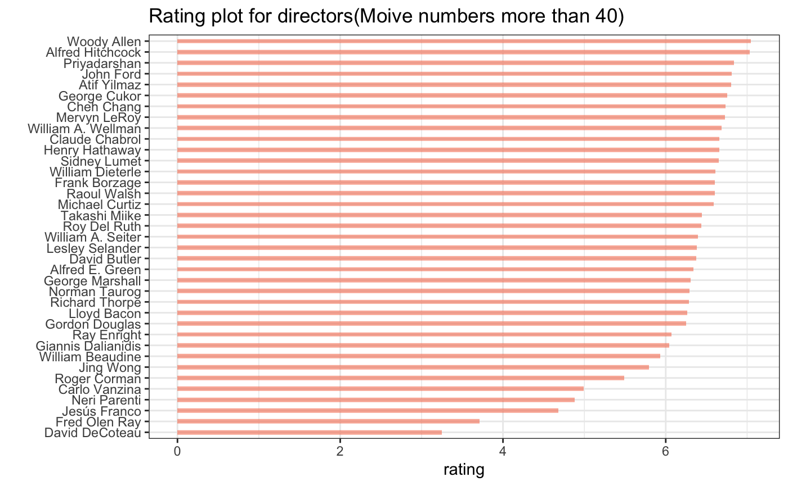
Q2: Does the choice of director affect the movie rating?
Woody Allen
Alfred Hitchcock
Priyadarshan
John Ford
Atif Yilmaz
Figure 11. The rating plot for directors that the movie number ≥40.

Slide 17
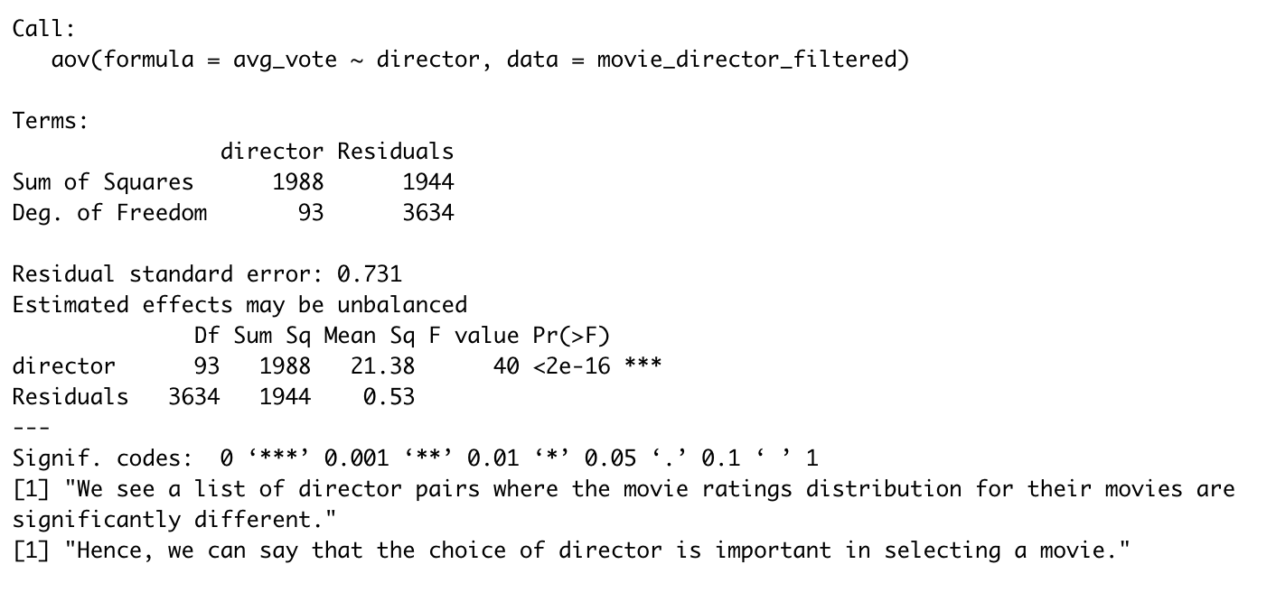
Anova testing among Rating and director

Slide 18
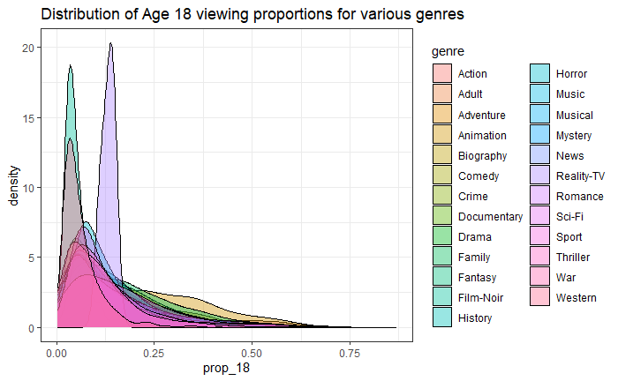
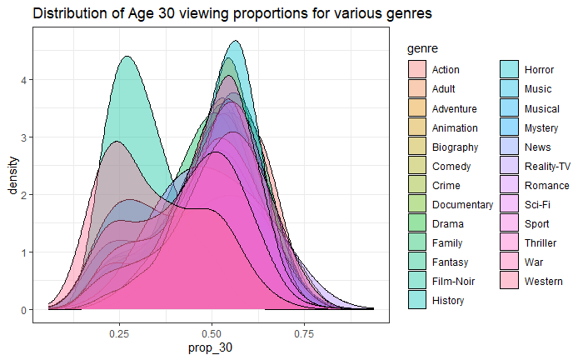
Q3: Movie genre views statistic differences with age
Figure 12. The distribution of age 18 for the movie genres.
Figure 13. The distribution of age 30 for the movie genres.

Slide 19
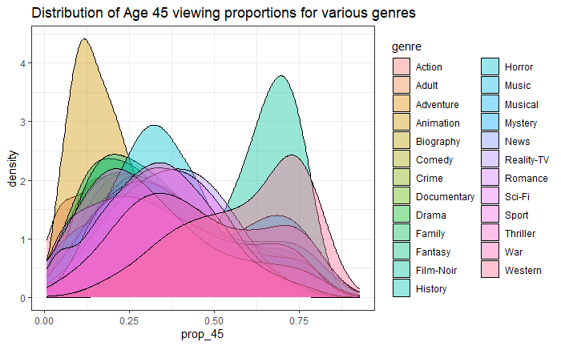
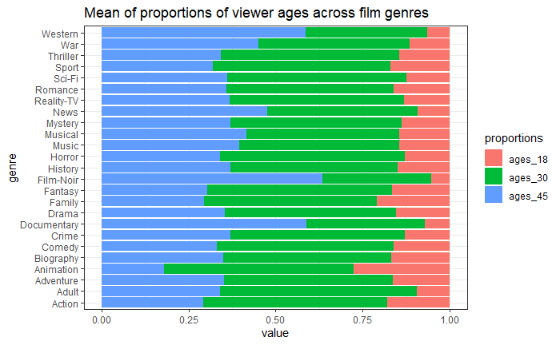
Figure 14. The distribution of age 45 for the movie genres.
Figure 15. The mean of proportions of viewer ages across genres.

Slide 20
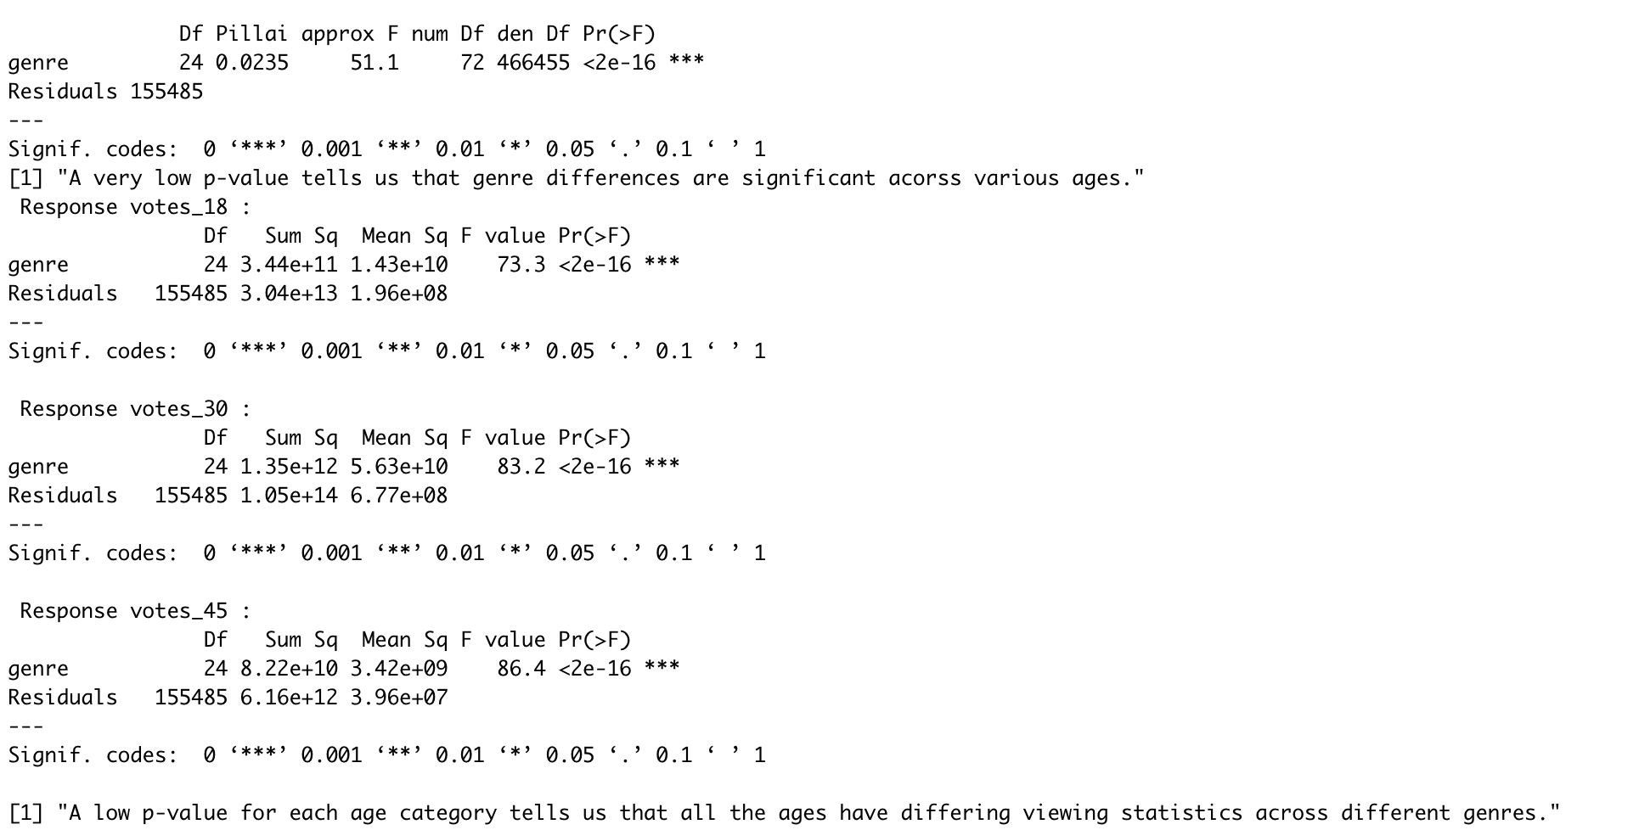
Anova testing among genre and age

Slide 21
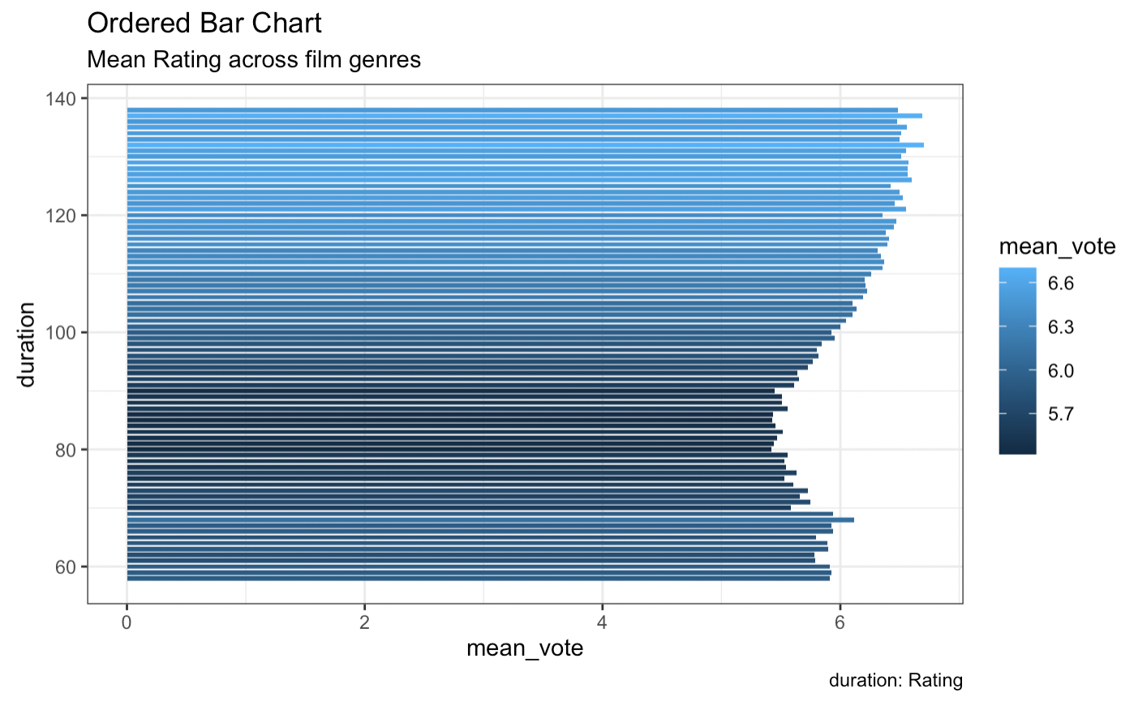
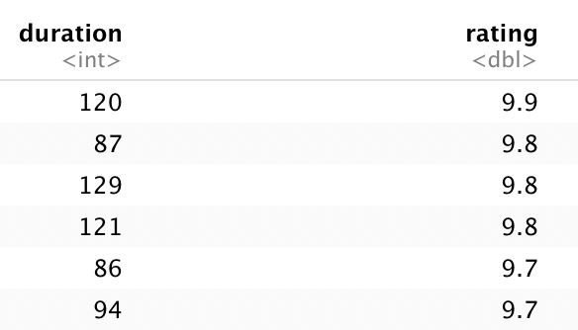
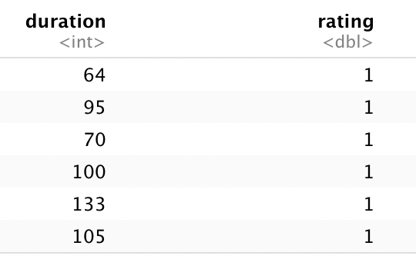
Q4: Movie duration and Rating distribution
Figure 16. The bar plot of movie duration vs. movie ratings.

Slide 22
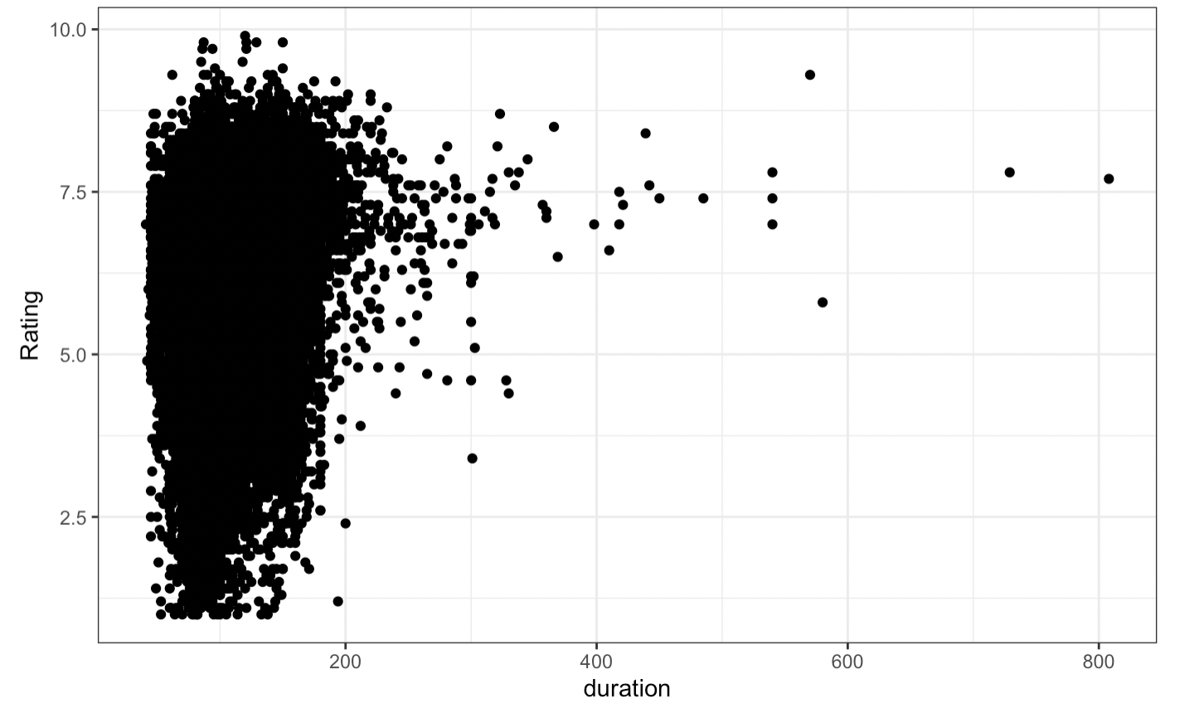
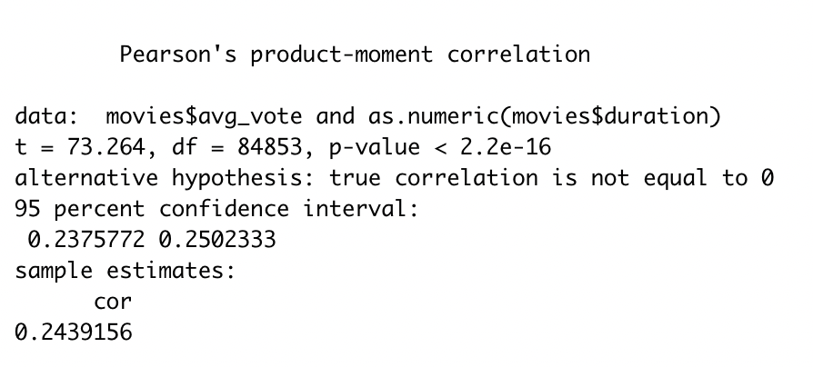
Q4: Movie duration and Rating distribution
Test : weak Correlation
Cor:0.2439
Figure 17. The scatter plot of movie duration vs. movie ratings.

Slide 23
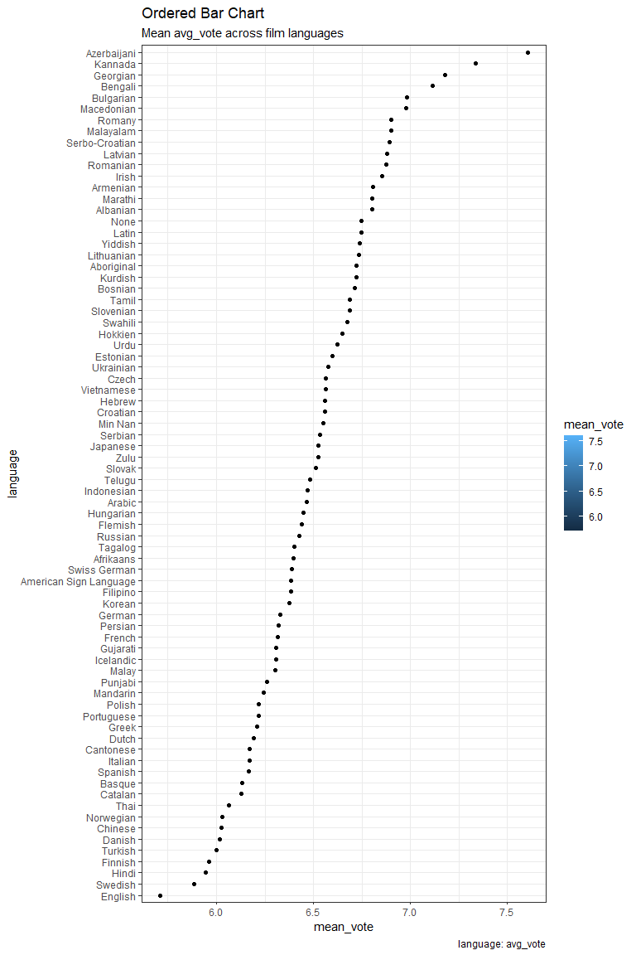
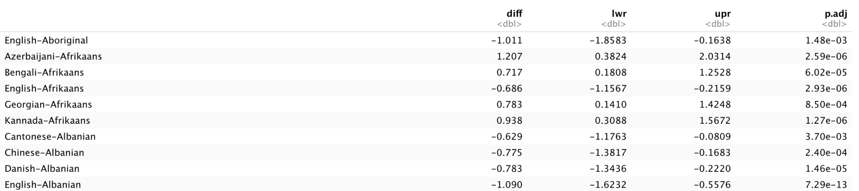
Q5: Movie Language and Rating distribution
Figure 18. The bar plot for movie language vs. movie rating.

Slide 24
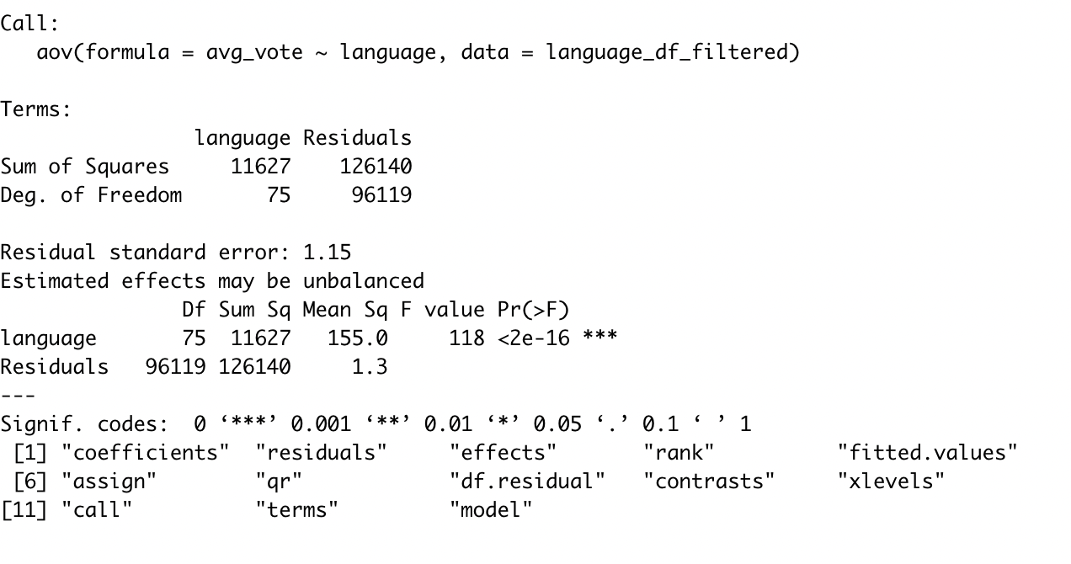
Anova Test for movie languages and ratings

Slide 25
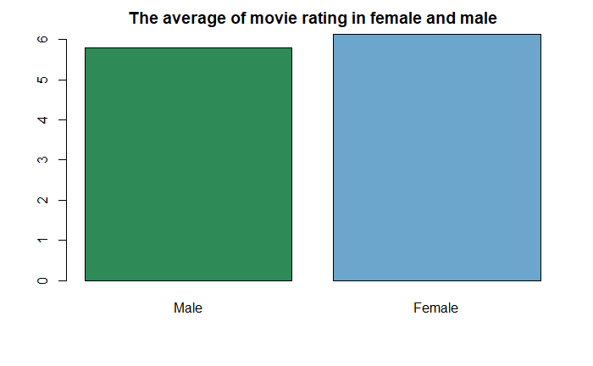
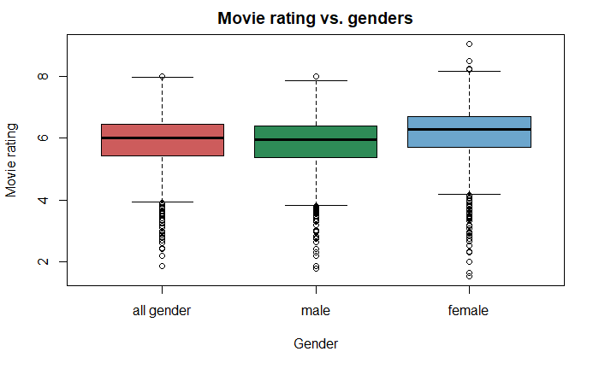
Q6: Do differences in genders have different average movie ratings?
Figure 19. The barplot for the average rating in genders.
Figure 20. The boxplot for the movie rating in genders.

Slide 26
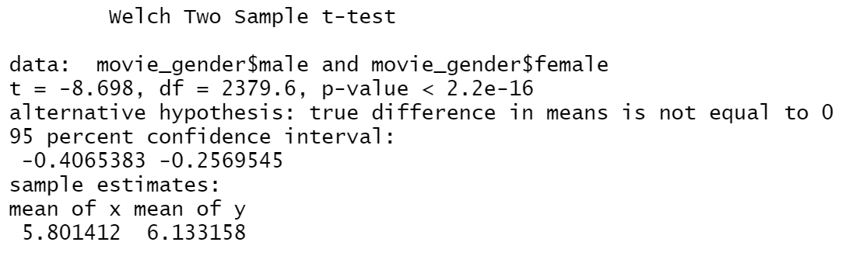
T-test for movie ratings in genders

Slide 27
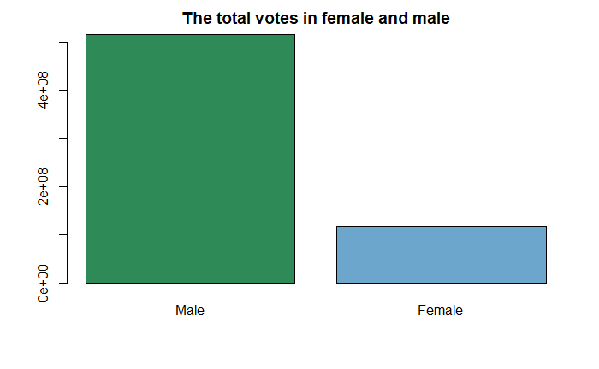
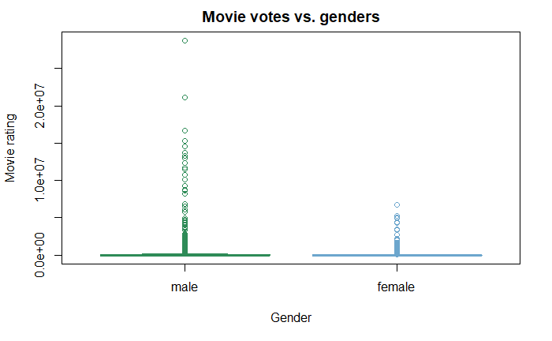
Q6: Do differences in genders have different amount of movie votes?
Figure 21. The barplot for the sum of movie votes in genders.
Figure 22. The boxplot for the movie votes in genders.

Slide 28
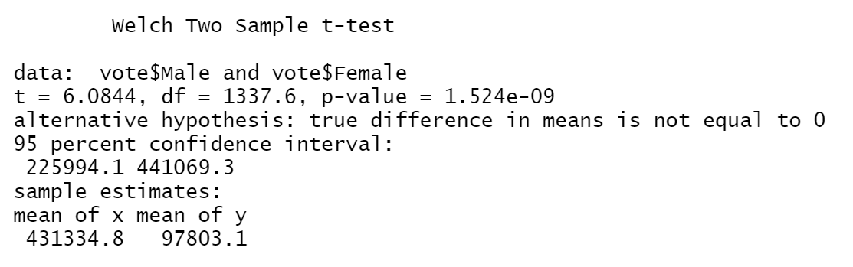
T-test for movie votes in genders

Slide 29
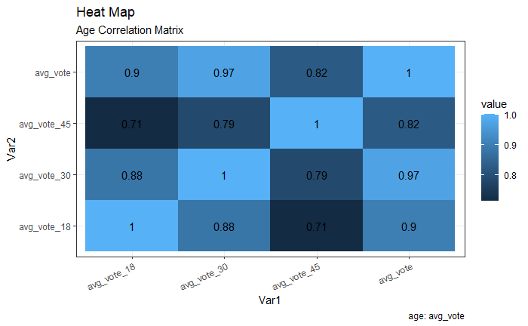
Q6 : Age correlation
Figure 23. The correlation plot for age.

Slide 30
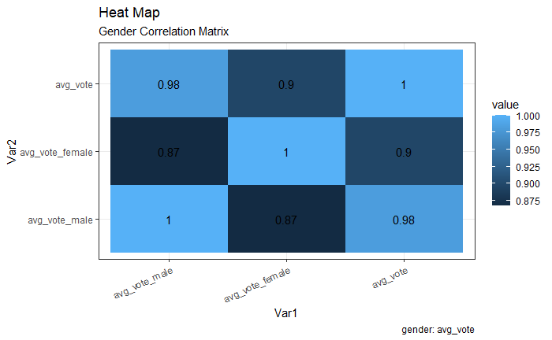
Q6: Gender correlation
Figure 24. The correlation plot for genders.

Slide 31
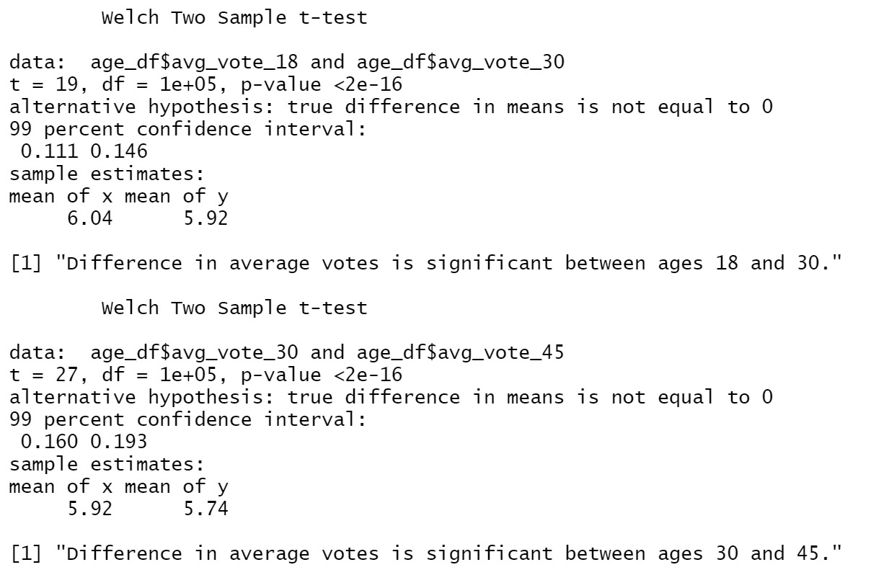
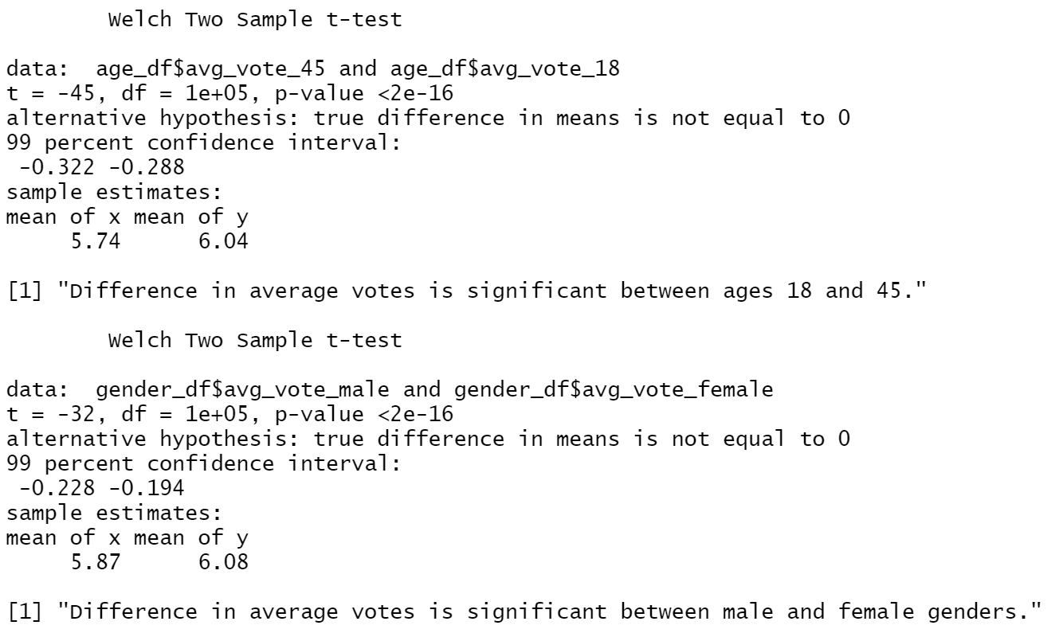
T- Test

Slide 32
Conclusions
The following are the variables and their effect on the avg_vote of the movie:
Genre
Director
Movie duration
Movie language
Voter demographics
After running hypothesis tests on these variables we arrived at the conclusion that the above factors are responsible for variations in avg_vote.

Slide 33
Future Work
We have not considered the cast demographics while checking for causes of variability in avg_vote.
Further analysis would make use of the IMDB names dataset as well to obtain more features.
Dataset only has movie information till January 2020. Effect of Covid-19 on movie ratings not possible on dataset.

Slide 34
References
https://www.kaggle.com/stefanoleone992/imdb-extensive-dataset
https://rstudio-pubs-static.s3.amazonaws.com/240657_5157ff98e8204c358b2118fa69162e18.html

Slide 35
Thanks for watching!

